Slide 1
Weekly Progress Report Activities

Slide 2
Data preparation for binary classification
DBE committed amount | Occurance | Continuous (numeric)
DBE commit amount | unique | Continuous (numeric)
Total bid amount | unique | Continuous (numeric)
Bid days | 64 | Continuous (numeric)
DBE target goal | 2 | Categorical (binary)
Training dataset
Target was achieved | Target was not achieved
324 | 30
Testing dataset
Target was achieved | Target was not achieved
105 | 13

Slide 3
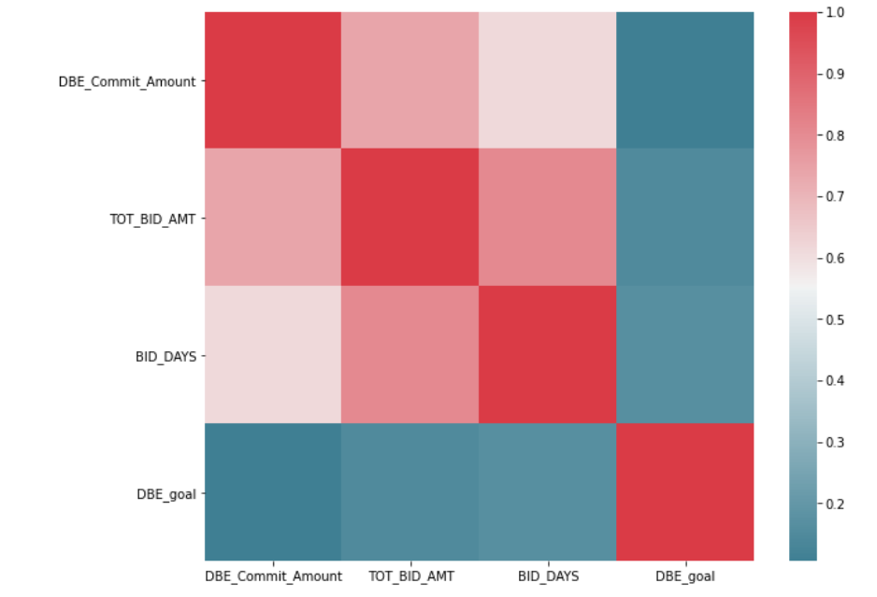
Correlation Matrix

Slide 4
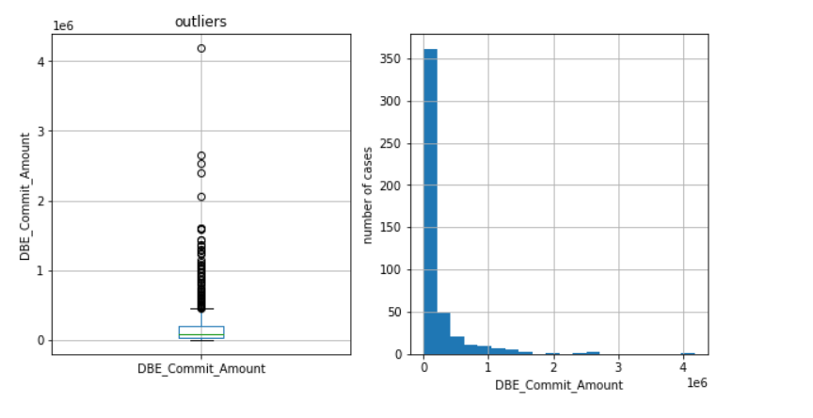
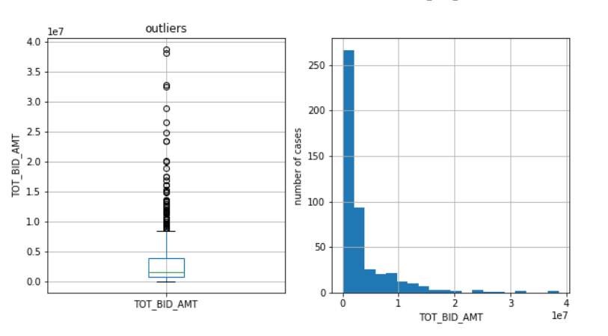
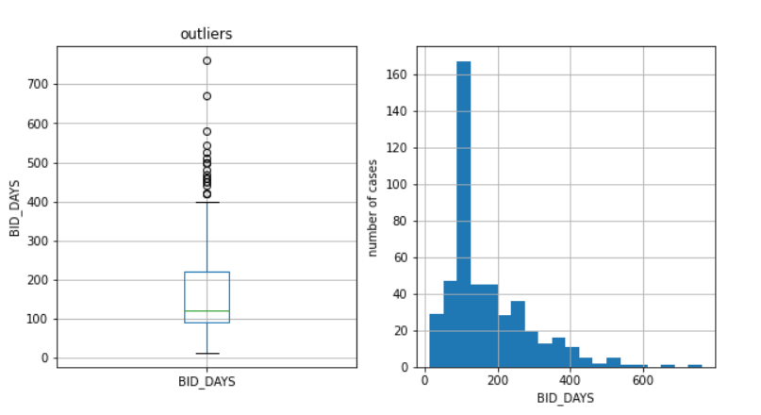
Feature Characteristics
Distributions and Outliers for continuous features.

Slide 5



Feature Characteristics

Slide 6
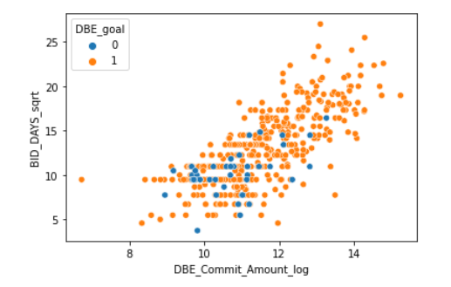
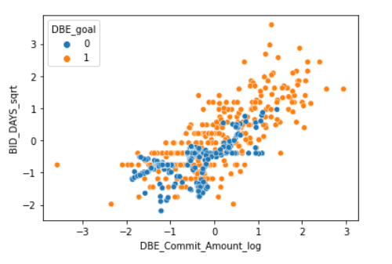
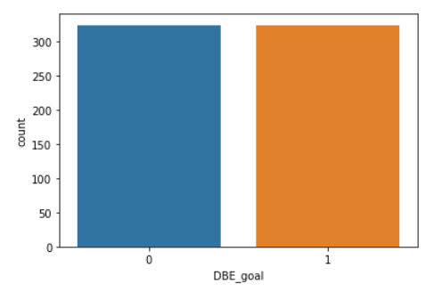
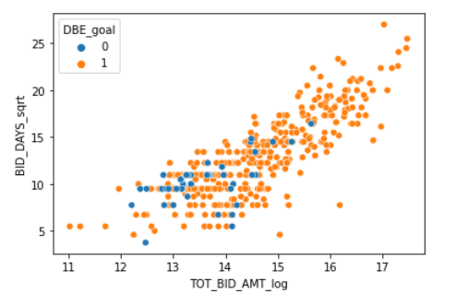
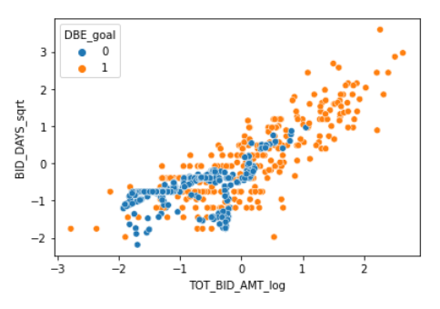
Data Oversampling with SMOTE

Slide 7
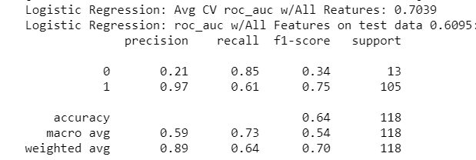
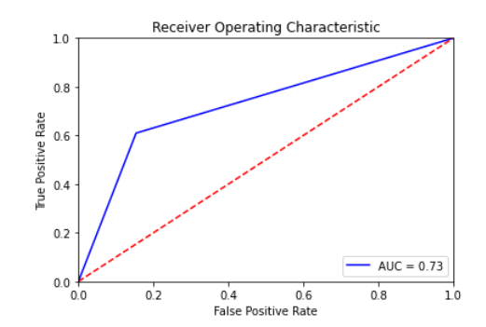
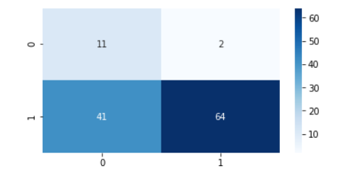
Best Models So Far 1- LR with SMOTE

Slide 8
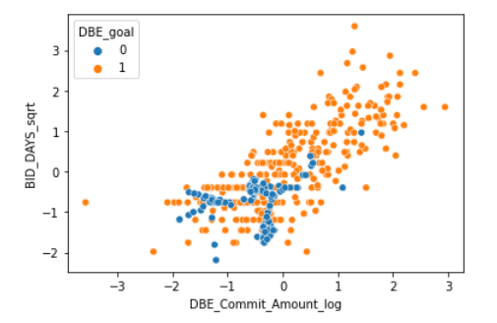
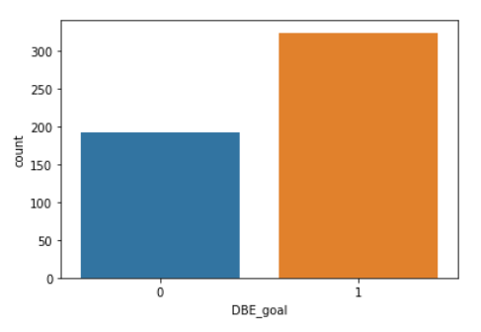
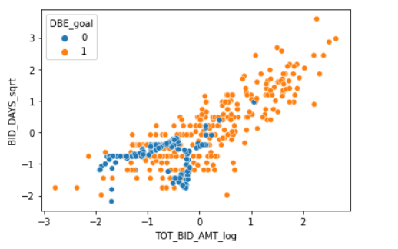
Data Oversampling with SVMSMOTE

Slide 9
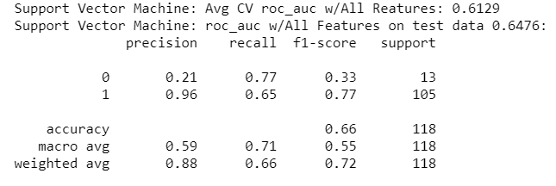
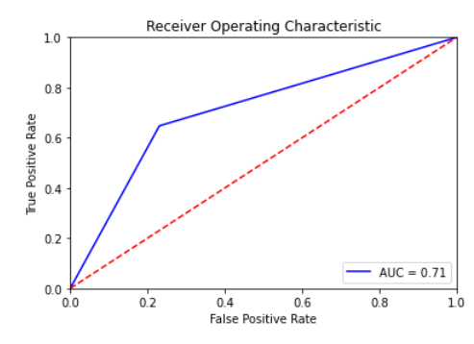
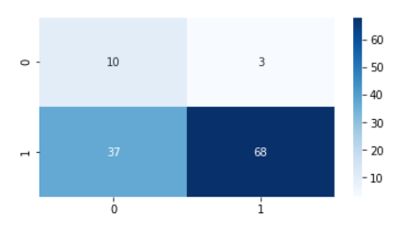
Best Models So Far 2- SVM with SVMSMOTE

Slide 10
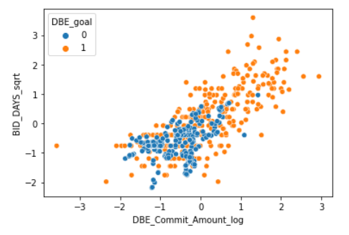
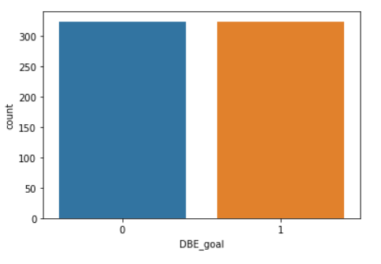
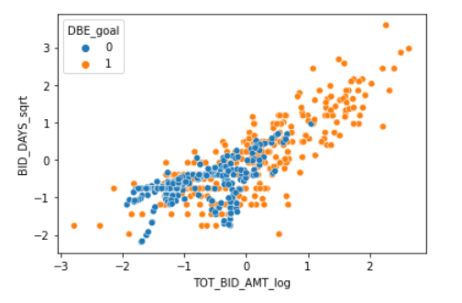
Data Oversampling with BLSMOTE

Slide 11

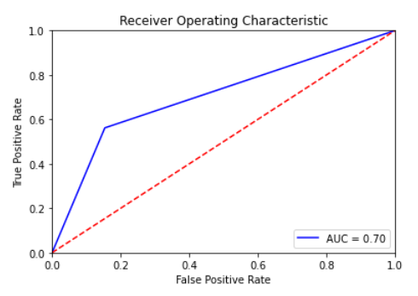
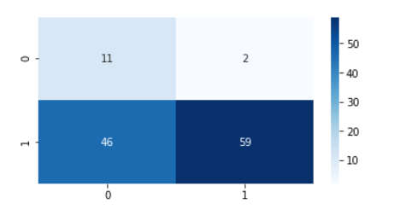
Best Models So Far 3- SVM with BLSMOTE

